Slide 1
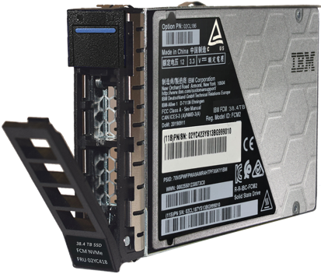
Why Add New IBM FlashSystems to Current Environment
Keep Existing Block Storage
Complement with newer capabilities of a FlashSystem for those applications deemed critical to the business using storage virtualization.
Easy Immutable Copies of Data
Turn on the included Safeguarded Copy feature to protect critical data even on virtualized storage arrays.
Industry Leading AI Technology for Ransomware Detection
New FlashCore Module 4 provides real-time AI-based analysis of every single Write I/O to determine potential data anomalies allowing for a quick response.
If end-user has older hardware
Customer with pre- Jan. 2021 Storwize/FlashSystem hardware eligible for First in Enterprise Incentives
Take advantage of the Storage Trade-in Program

